Slide 1

Avista
SharePoint Solution Showcase

Slide 2
Avista –Intranet Development and Stream Migrations
Business Problem
Pain Point: End-of-life for Stream Classic on February 15th forced Avista to migrate to Stream SharePoint Online. Their company-wide training videos were scattered across YouTube, Stream Classic, and a third-party site, with over 300 videos requiring migration.
What We Did
Stream Migration Tool: Leveraging expertise in MS 365 and SharePoint, Affirma utilized the Stream migration tool to seamlessly migrate all videos from Stream Classic to SharePoint Online Stream.
Metadata and Permissions: Transcript, metadata, and permissions were meticulously preserved during the migration, ensuring continuity and access control.
Custom Metadata and Search: Affirma created custom metadata for efficient video tagging, along with implementing a custom search function for users to effortlessly locate videos within SharePoint Online.
Stream Hub Site: To enhance user experience, a visually appealing Stream Hub site was designed to host all migrated videos.
Results
Successful Migration: All 300+ videos were migrated to Stream SharePoint Online before the Stream Classic deadline.
Preserved Information: Transcript, metadata, and permissions were maintained throughout the migration process.
Improved Search Functionality: Custom metadata and search features enable users to quickly find the videos they need.
Enhanced User Experience: A streamlined Stream Hub site provides a centralized and user-friendly location for all training videos.

Slide 3
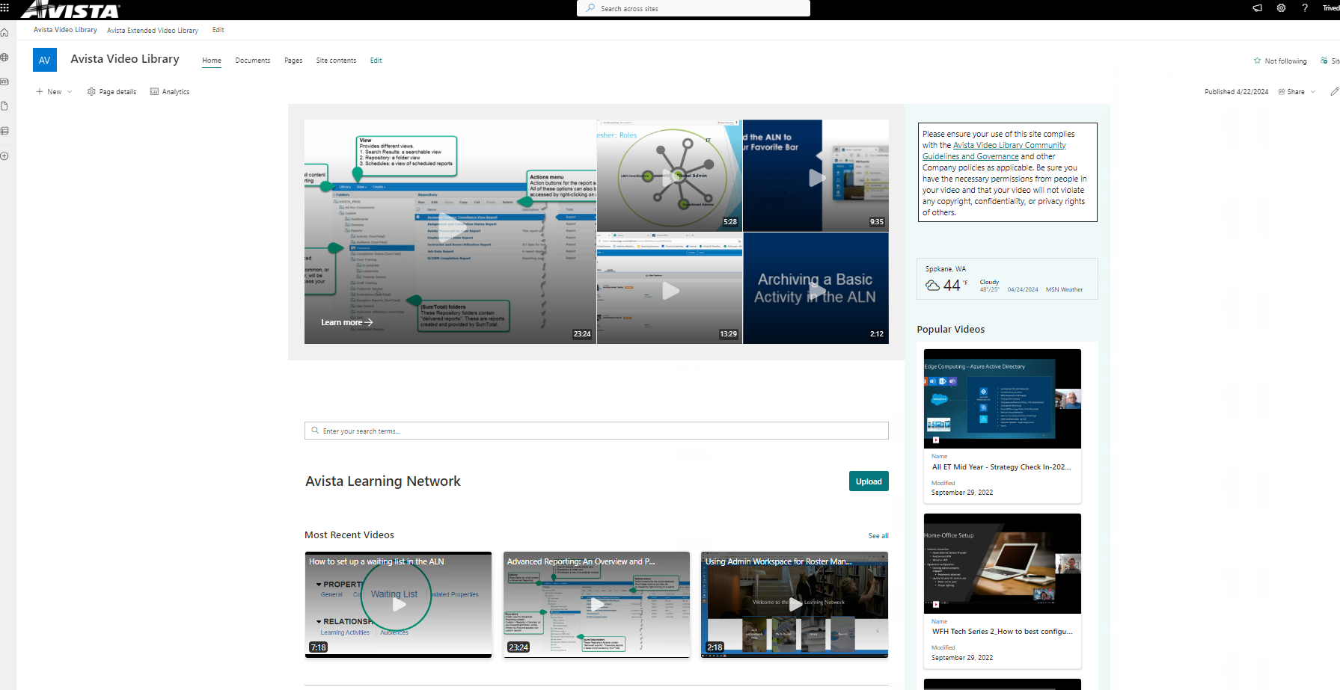
Avista SharePoint “Video Library”

Slide 4
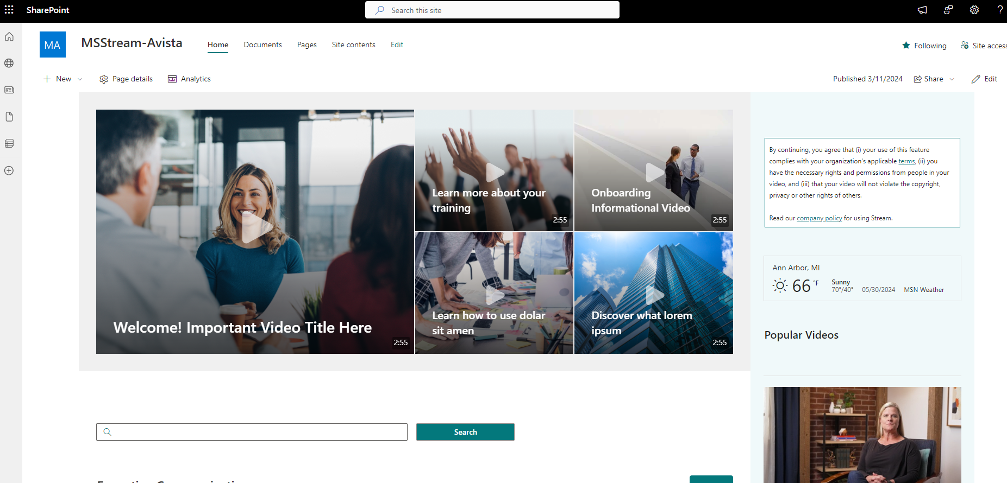
Avista SharePoint “Video Library”

